Slide 1
Thermodynamik III
Kältemaschinen, Oxyfuel, Carbon Capture and Storage
HS2021
Dr. Ndaona Chokani

Slide 2
Overview
Vorlesung |  | Übung/Beispiel
Datum | Thema | Datum | Thema
09.11 | Prozess des Energieaustausches | 09.11 | Geschwindigkeitsdreiecke
16.11 | Dampfkraftprozesse | 16.11 | Rankine Zyklus
23.11 | Gasarbeitsprozesse - Verbrennungsmotoren | 23.11 | Diesel / Otto Zyklus
30.11 | Gasarbeitsprozesse - Gasturbinenprozesse | 30.11 | Brayton Zyklus
07.12 | Gasarbeitsprozesse - Kombinierten Zyklen | 07.12 | Kombinierter Zyklus
14.12 | Kältemaschinen und Wärmepumpen | 14.12 | Kältemaschine/Wärmepumpe
21.12 | Kältemaschinen Oxyfuel, Carbon Capture and Storage | 21.12 | Wärmepumpe
2

Slide 3
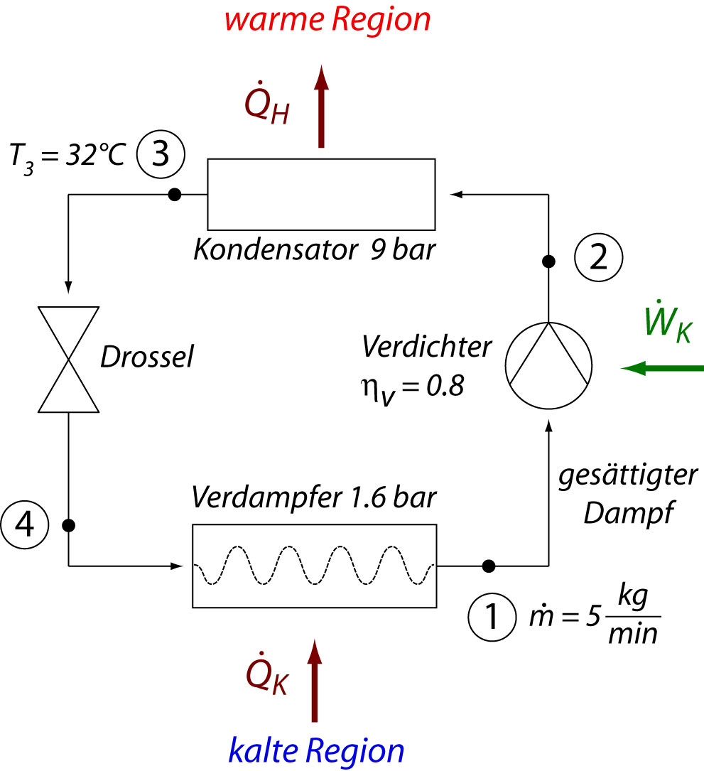
Beispiel
Kompressionskältemaschine, Arbeitsmittel: R134a (CF₃CH₂F)
gesucht:

Slide 4
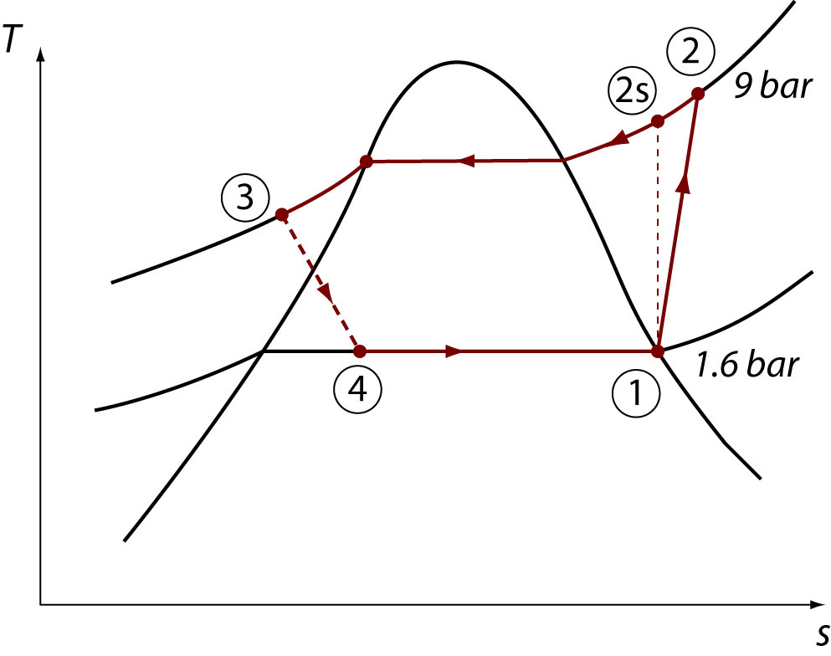
Lösung:
Zustand 1:
Gesättigter reiner Dampf
p₁ = 1.6 bar, Tabelle: h₁ = 237.97 kJ/kg, s₁ = 0.9295 kJ/kgK
Zustand 2s:
s_{2S} = s₁, p_{2S} = 9 bar, Tabelle −> h_{2S} = 273.73 kJ/kg
Wirkungsgrad des Verdichters:

Slide 5
h₂ = 282.67 kJ/kg
(p₂ = 9 bar) Tabelle: s₂ = 0.9576 kJ/kgK
Zustand 3:
p₃ = 9 bar, T₃ = 32 °C (unterkühlte Flüssigkeit)
Tabelle: h₃ -> h_{f}(32°C) = 94.39 kJ/kg
Tabelle: s₃ -> s_{3f}(32°C) = 0.349 kJ/kgK
Zustand 4:
h₄ = h₃, p₄ = 1.6 bar
x₄ = 0.3104, s₄ = 0.37198 kJ/kgK

Slide 6
Leistungsziffer:
Entropiebilanz für den Verdichter:
Entropiebilanz für die Drossel:

Slide 7
Carbon Capture and Storage (CCS)
Capture
Transport
Storage

Slide 8
Carbon capture
CO₂ can be separated from a carbon emission source either before or after it has been combusted to produce energy or other products (cement, steel, etc.). There are three ways to capture CO₂ from these combustion processes:
Pre-combustion technology
Post-combustion technology
Oxyfuel combustion
Innovative thermodynamic cycle

Slide 9
Oxyfuel power plant
Pump
Burn carbon based fuels with oxygen
Combustion main products: CO₂, H₂O
Different cycles have been developed: Water cycle, Graz cycle, and Matiant cycle

Slide 10
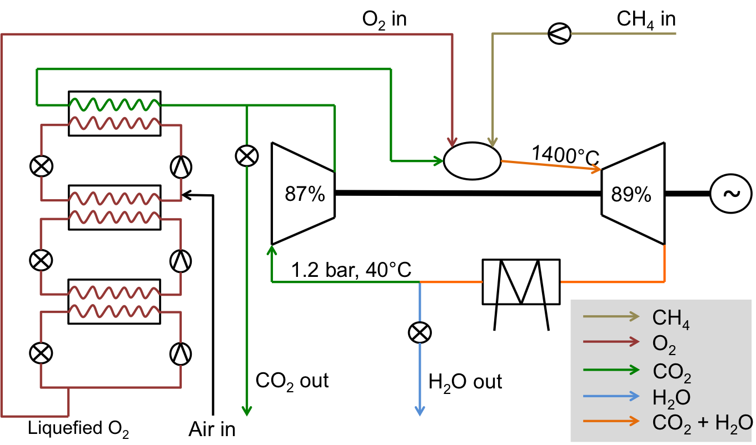
Oxyfuel power plant schematic
m_{CO2} = 1000 kg/s

Slide 11
Performance over pressure ratio
Power required to liquefy and separate oxygen reduces efficiency of cycle
Compared to normal Brayton cycle, Oxyfuel cycle has 7-10% lower efficiency and 15-25 MW lower power output

Slide 12
Performance over temperature ratio

Slide 13
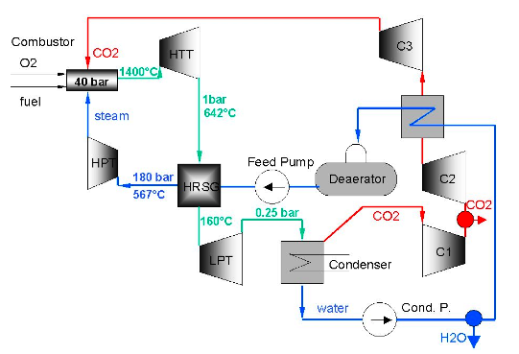
Graz cycle
Combination of a high temperature Brayton cycle, and a low temperature Rankine cycle
Brayton
To CO₂ storage
Rankine
[H. Jericha, et al., ASME paper GT2003-38120]

Slide 14
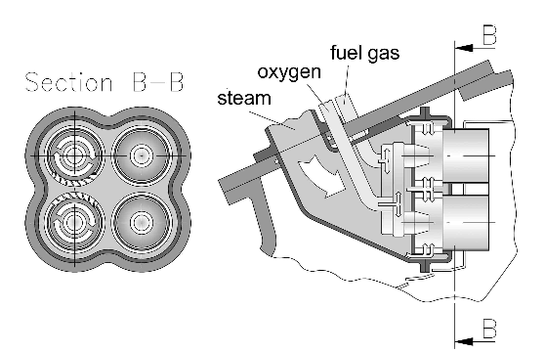
Combustion:
Fuel with high hydrogen content (e.g.: CH₄) is mixed in stochiometric ratio with O₂
Negligible N₂ content → no NO_{x} production
Danger of too high flame temperature (in normal combustion 70% of the gas is just getting heated, but here 100% is reacting), danger of dissociation of the products
Need of cooling medium: CO₂ from C3, H₂O from HPT
Combustion at 40bar, exit temperature 1400°C, heat released: 1.62MJ/kg
Mixture leaving the combustor of about 74% steam, 25.3% CO₂, 0.5% O₂, 0.2% N₂

Slide 15
Expansion:
3 turbines, 2 for H₂O+CO₂, 1 for H₂O, total turbine power: 1.25MJ/kg
Compressors and pumps:
3 compressors for CO₂, 2 pumps for H₂O, total power consumption: 0.21MJ/kg
Heat recovery steam generator (HRSG):
HSRG brings the steam to 180bar and 567°C, cooling the mixture 482°C
Further components:
O₂ generator: needs 1.08MJ/(kg of O₂) or 50.9kJ/(kg of mixture)
O₂ compressor: brings the O₂ from atmosphere to burner pressure level, needs 0.87MJ/(kg of O₂) or 41kJ/(kg of mixture)
Overall maximum theoretical efficiency:
η_{th}=η_{gen}(W_{HTT}+W_{HPT}+W_{LPT}-W_{C1}-W_{C2}-W_{C3}-W_{pump1}-W_{pump2}-W_{O2gen}-W_{O2compr})/Q_{comb}
= 57.5%

Slide 16
Comments:
CO₂ storage has to be safe
Pilot power plants in Texas and Berlin
The power plant has to be close to the storage point to avoid CO₂ transportation costs

Slide 17
Population in Europe
Difficult to find safe spot for carbon dioxide storage in Europe, due to population density
One option is in the ocean while another is mineralization

Slide 18
Scenario analysis: How can EU achieve 45% renewable electricity by 2030?
EU targets 45% renewable electricity by 2030
Unlike for 2020 targets, no targets for individual countries are derived for 2030
Which combination of wind and solar, being installed in which locations, will achieve EU target with lowest detrimental effects on cost and security of supply?

Slide 19
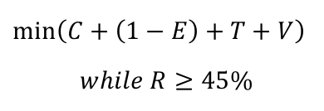
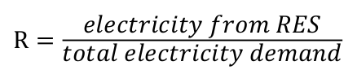
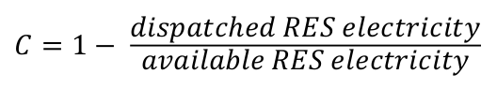
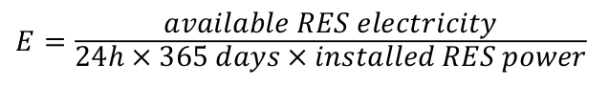
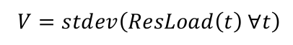
45%-RES study: Optimization target
Optimum shall respect energy policy trilemma: Sustainability, competitiveness and security of supply
Optimization target
Where
Renewable share
Curtailment
Energy capacity factor
Transmission lines
Variability of residual load

Slide 20
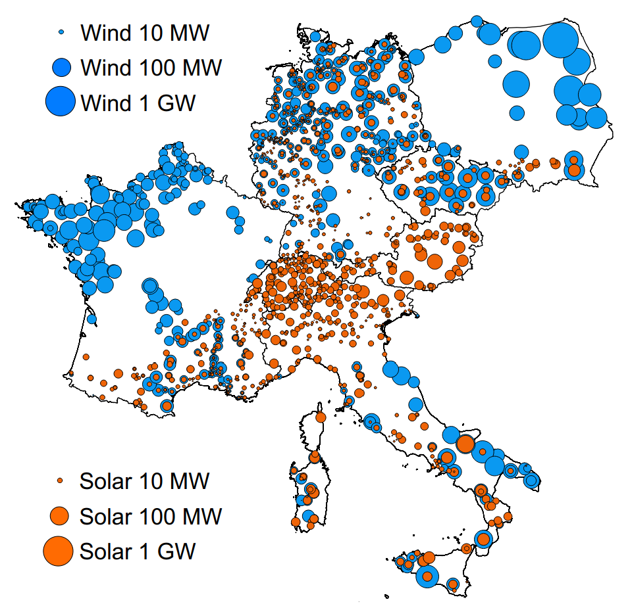
Results: Optimal RES portfolio across Europe
To achieve 45% RES target, 221 GW of wind and 82 GW of solar need to be installed across central Europe
 | Installed Wind [GW] | Installed Solar [GW]
AUT | 2 | 12
CZE | 14 | 6
DEU | 60 | 15
FRA | 72 | 9
ITA | 33 | 26
POL | 37 | 2
SUI | 3 | 12
Total | 221 | 82
Optimal RES portfolio to achieve 45% renewable electricity in central Europe by 2030
P Eser, N Chokani, RS Abhari 2017 IEEE Power & Energy Society General Meeting, 1-5

Slide 21
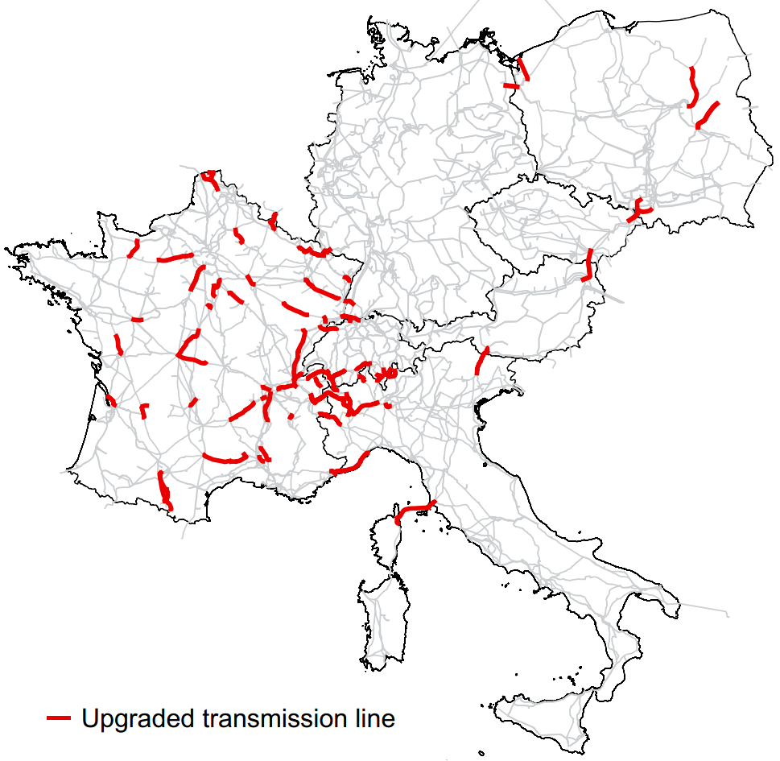
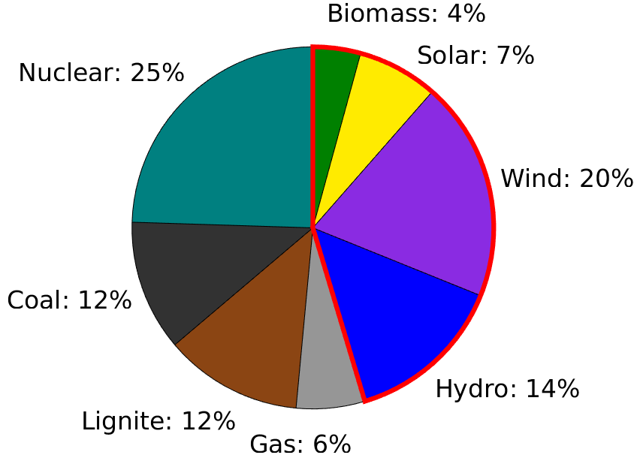
Results: Transmission grid in Italy limits penetration of solar power
Contribution of solar power to 45% RES goal is limited, because transmission lines between Italy and rest of Europe are bottlenecks

Slide 22
Exam topics
Velocity triangles for compressors and turbines:
Relative and absolute velocities
Work, Power, Δh, Δp
Calculate the thermodynamic properties in the process points around a cycle with and without tables
Draw T-s and p-V diagrams
Use the turbine/compressor efficiency
Calculate work and heat
Calculate the thermal efficiency
Understand issues and potential solutions for carbon capture and storage

Slide 23
Cycles
Rankine cycle
Otto cycle
Diesel cycle
Brayton cycle
Stirling cycle
Carnot cycle: heat pump / refrigerator
Combined cycles (combination of all the cycles above)

